Slide 1

An Overview of Software Defined Networking (SDN)
Dr. Uttam Ghosh
Computer Science
Vanderbilt University
Uttam.ghosh@vanderbilt.edu

Slide 2



The Present Era….

Slide 3



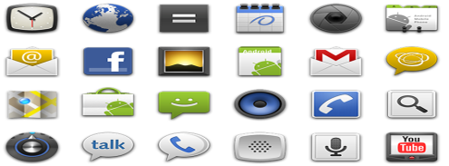





OS Support for Networking- Where are We?
Operating System
User Space
Application
Application
Application
Network
Application Layer
HTTP
Transport Layer
TCP
Kernel Space
Network Layer
IP
Data Link Layer
Ethernet
Physical Layer
Ethernet Driver
Hardware
Network Interface Card

Slide 4

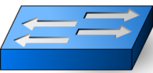
Interaction between Layers in TCP/IP Stack
Forwarding device (Switch)’
Host 1
Host 2
Layer 5
Application Layer
Application Layer
Layer 4
Transport Layer
Transport Layer
Layer3
Network Layer
Network Layer
Layer 2
Data Link Layer
Data Link Layer
Data Link Layer
Layer 1
Physical Layer
Physical Layer
Physical Layer
Interface
Physical Communication
Protocol

Slide 5
Goal of the Lecture
We will discuss the traditional networking and how Software Defined Networking brings the revolution using network operating system (NOS).
Software Defined Networking – the biggest break through of computing of the last decade.
We will categorically elaborate the features which make SDN an emerging technology.
Finally we will discuss SDN integration- applications of SDN.
Notes:
SDN separates the control plane from the data plane freeing software innovation cycles to become independent of hardware innovation cycles.
SDN accelerates Internet and Cloud innovation while significantly reducing the costs of building and operating networks.
A PhD dissertation of Martin Casado, Stanford [2008]

Slide 6
Planes of Network
Switch
Control Plane:
Make forwarding decisions (routing table) and program (packet handling policies) data plane
Handled by CPU
Control Plane
CPU
Memory
Data Plane
Forwarding Hardware
Data Plane:
Data forwarding and processing.
Runs at line rate (Fast Path).
Management Plane:
Responsible for controlling and monitoring of network devices
Instantiate new devices and protocols (turn devices on/off)

Slide 7

Problem of Legacy Network Devices
Too Complicated:
Control plane is implemented with complicated software and hardware
App
App
…
App
App
App
…
App
Operating System
Operating System
Specialized Data
Forwarding H/W
Specialized Data
Forwarding H/W
Closed Platform: Vendor Specific
App
App
…
App
App
App
…
App
Hard to Modify (nearly impossible):
Hard to add new functionalities (applications)
Operating System
Operating System
Specialized Data
Forwarding H/W
Specialized Data
Forwarding H/W
Closed
Cannot dynamically change according to network conditions
New proposal: Software Defined Networking
Notes:
Control plane is implemented with complicated software (million of lines of source code) and hardware (billion of gates)

Slide 8
Legacy Network Versus SDN
SDN Application
SDN Application
SDN Application
SDN Application
Control Plane
Control Plan
Data Plane
Data Plane
SDN Control Plane
Control Plane
Control Plane
Data Plane
Data Plane
Control Agent
Control Agent
Data Plane
Data Plane
Legacy Network
Control Agent
Data Plane
Software Defined Network
Legacy/Traditional Network
Network of closed and proprietary components (switches)
Software Defined Network
Separation of control plane and data plane
Open interface between control plane and data plane
Easy to add new functionalities (applications) as control plane is programmable

Slide 9

Key Idea: Separation of Control & Data Planes
Control Plane Intelligence
Controller
Secure and reliable channels
OpenFlow Protocol
Secure Channel
Secure Channel
Secure Channel
OpenFlow switch
Flow Table
Flow Table
Flow Table
OpenFlow (OF) Switch
OpenFlow (OF) Switch
OpenFlow (OF) Switch
Control logic is moved to a controller.
One controller (mostly Open Source) with a lot of cheap switches.
Switches only have forwarding elements.
OpenFlow is the protocol to send/receive forwarding rules from controller to switches.
OpenFlow should be reliable (TCP) and secure (SSL).

Slide 10




SDN Architecture
SDN Applications
Routing
QoS
Management
Application Plane
North Bound Interface
Control
Plane
Network Operating System(SDN Controller)
Global View
South Bound Interface
Network Infrastructure
Data Plane
Forwarding Devices

Slide 11

What is SDN?
The physical separation of the network control plane from the forwarding (data) plane, and where a control plane controls several devices.
Directly programmable: Controller is programmable.
Agile: Abstracting control from forwarding
Centrally managed: Controller is logically centralized.
Programmatically configured: Network can be configured by controller programs.
Open standards-based vendor neutral

Slide 12

OpenFlow: Bootstrapping
Switch
Switches need initial configuration: Switch IP address, controller IP address and default gateway
Switches connect to the controller
Switch provides configuration information about ports
Controller
Controller sends a LLDP request to all neighbors (switches)
Controller determines the topology from LLDP responses

Slide 13


SDN: Working Principles
Network Operating System
1
H2 sends packet to S3
Topology Manager
Routing Manager
2
S3 forwards the packet to Controller
Host Tracker
Switch Manager
3
Controller computes path S3-S2-S1 and sends flow rules to switches:
For S3: H2 →S2: Forward
For S2: S3 →S1: Forward
For S1: S2 →H1: Forward
SDN Controller
3
Control Plane
2
3
S3, S2 and S1 forward the packet to H1 as per flow table.
4
S4
1
3
S3
Data Plane
S1
4
4
H1
S2
4
H2
5
H2-S3-S2-S1-H2
5
H2 sends remaining packets to
H1 through S3-S2-S1 as a flow.

Slide 14

Virtualization using SDN
VLAN 2
VLAN 0
Controller
VLAN Manager
App Manager-
VLAN 1
Switch
Switch
Switch
Host 1
Host 2
Host 3
Host 4
Host 5
Host 6

Slide 15

Dynamic Slicing
Virtual Network 2
Virtual Network 1
Physical Network
Slicing software like FlowVisor slices OpenFlow networks, creating multiple isolated and programmable logical networks on the same physical topology.
Tenants need complete control over their addresses, topology, and routing, security. SDN provides virtual tenant network using dynamic slicing from a same physical substrate.

Slide 16

Service Integration in SDN
Network Operating System
Firewall.c
.. .
If (pkt->tcp->dport == 80)
dropPacket(pkt);
.. .
Topology Manager
Routing Manager
Host Tracker
Firewall
SDN Controller
Control Plane
S4
S3
Data Plane
S1
S2
H1
H2
Load balancers, firewalls, Intrusion Detection Systems (IDS), provisioned on demand and placed appropriately on the traffic path

Slide 17
Integration of SDN: Applications
Cloud Computing
Internet of Things
Mobile Computing
Information Centric Networking (ICN)
Critical Infrastructure (Cyber Physical) Security

Slide 18
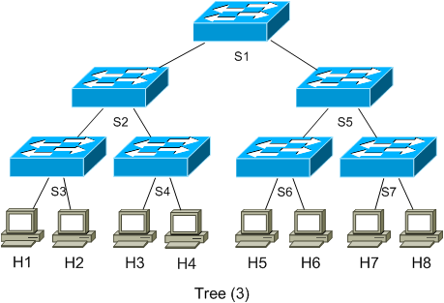
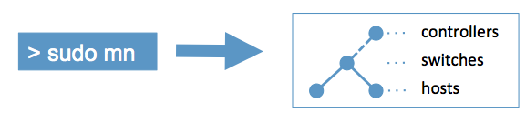
Mininet- An Emulator for SDN
Mininet creates a realistic virtual network, running real kernel, switch and application code, on a single machine (VM, cloud or native), in seconds, with a single command.
Source: http://mininet.org/

Slide 19
Forums and Standards
ONF- Open Networking Foundation- open, collaborative consortium of industry academia
How to reach: https://www.opennetworking.org/
OpenDayLight – Linux Foundation Projects, open source SDN platform
How to reach: https://www.opendaylight.org/
ONOS - Open Network Operating System (ONOS) is an open source SDN network operating system designed for building next-generation SDN/NFV solutions.
How to reach: https://onosproject.org/
OpenStack: Open source software for creating private and public clouds.
How to reach: https://www.openstack.org/
IEEE Standardization: IEEE standardization efforts to advance software defined networks are currently under way.
How to reach: https://sdn.ieee.org/standardization
IETF and RFC: Several ongoing proposals could be found in IETF and RFC.
How to reach: https://www.ietf.org/

Slide 20
SDN Solution- State-of-the-art
SDN Applications
Routing
QoS
Management
Application Plane
North Bound Interface
RYU
NOX
Floodlight
FlowVisor
PFC
Control
Plane
ODL
POX
RouteFlow
South Bound Interface
Commercial H/W
HP
OpenSource S/W
Data Plane
OpenVSwitch
NEC
Lagopus VSwitch
Cisco
OpenWRT
Juniper
Source: https://www.sdxcentral.com/sdn/

Slide 21
Recommended Reading
P. Saint-Andre, et al., “XMPP: The Definitive Guide,” O’Reilly, 2009, 320 pp., ISBN:9780596521264 (Safari Book)
Prof. Raj Jain, “Introduction to Software Defined Networking (SDN)”.
U. Ghosh, P. Chatterjee, S. Shetty, C. Kamhoua, and L. Njilla, “Towards Secure Software-defined Networking Integrated Cyber-Physical systems: Attacks and Countermeasures", in Springer Versatile Cyber-Security, 2019.
Kreutz et al., towards secure and dependable software-defined networks, SigCom 2013.
Shin et al., Attacking Software-Defined Networks: A First Feasibility Study , HotSDN, 2013.
U. Ghosh, Z. Wang, X. Dong, R. Tan, Z. Kalbarczyk, D. Yau and R. K. Iyer, “ An Empirical
Study on Smart Grid Resilience under Software-Defined Networking Controller Failures", in ACM CPSS 2016, Xi'an, China.

